Slide 1
Giant Cell Arteritis
Randy Kardon M.D. Ph.D.
Department of Ophthalmology and Visual Science
University of Iowa Hospital and Clinic &
Veterans Administration
Iowa City, Iowa
Notes:
Title slide

Slide 2
Giant Cell Arteritis
References:
Hayreh SS, Zimmerman B.Management of giant cell arteritis. Our 27-year clinical study: new light on old controversies.Ophthalmologica. 2003 Jul-Aug;217(4):239-59.
Hayreh SS, Zimmerman B, Kardon RH.Visual improvement with corticosteroid therapy in giant cell arteritis. Report of a large study and review of literature.Acta Ophthalmol Scand. 2002 Aug;80(4):355-67. Review
Giant cell (temporal) arteritis: an overview and update. Survey of Ophthalmol. 2005 Sep-Oct;50(5):415-28. Review
Hayreh SS.Ophthalmic features of giant cell arteritis Baillieres Clin Rheumatol. 1991 Dec;5(3):431-59. Review.
Notes:
Key words and References

Slide 3
Giant Cell Arteritis
When elderly people begin to fail mentally and physically this disorder should be one of the first to be considered
Pauley JW, Hughes JP: BMJ 1960, 2:1562
Notes:
Giant cell arteritis or temporal arteritis is a disorder affecting the elderly (usually over the age of 65 with a few cases as young as 55 years old)

Slide 4
Giant Cell Arteritis
One of the few emergencies in ophthalmology that requires immediate treatment and may result in bilateral blindness if untreated.
Notes:
Giant cell arteritis, if untreated can result in total blindness due to infarct to the optic nerves

Slide 5
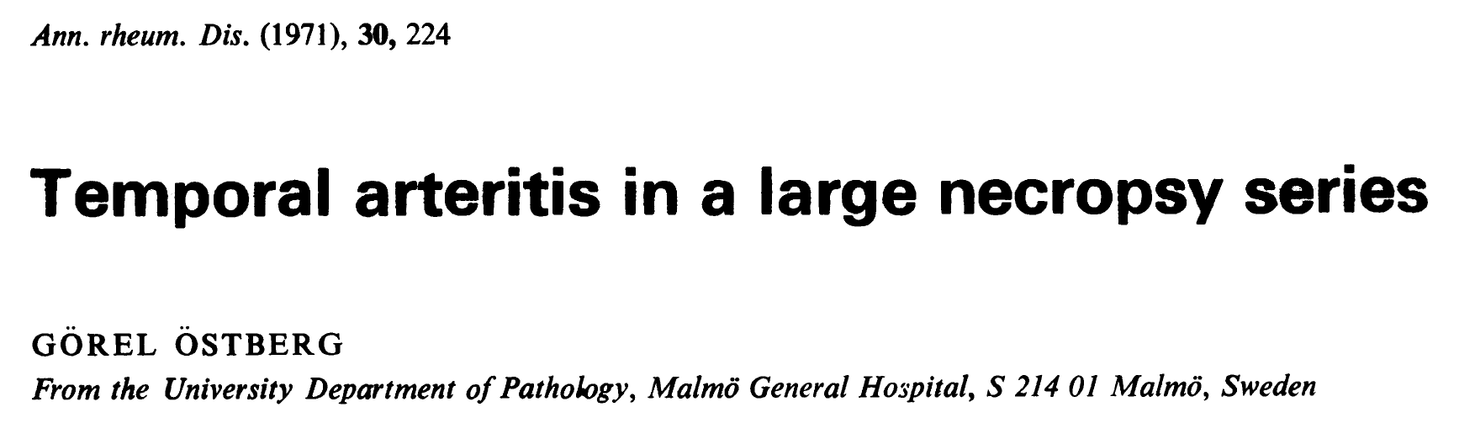
Found 16/1,097 (1.6%) positive histologic evidence for giant cell arteritis in temporal artery specimens collected at necropsy at a time when 65% of Malmo population had necropsy at time of death.

Slide 6
Giant Cell Arteritis Learning Objectives:
Describe why giant cell arteritis is considered an ocular emergency
List the common systemic and eye symptoms of giant cell arteritis
List the laboratory and pathologic findings in giant cell arteritis
Describe the most common mechanism by which giant cell arteritis causes blindness
List the objectives of treatment
Notes:
Learning objectives

Slide 7
Giant Cell Arteritis
Presenting Symptoms
This is a granulomatous inflammation of arteries and symptoms depend on which arteries are involved, producing ischemia
vision loss (permanent)
headache, neck pain, jaw claudication
scalp tenderness
acute abdomen
malaise, anorexia, flu-like symptoms
myocardial infarct, aortitis
Notes:
Presenting symptoms are a consequence of granulomatous narrowing of medium sized arteries throughout the body

Slide 8
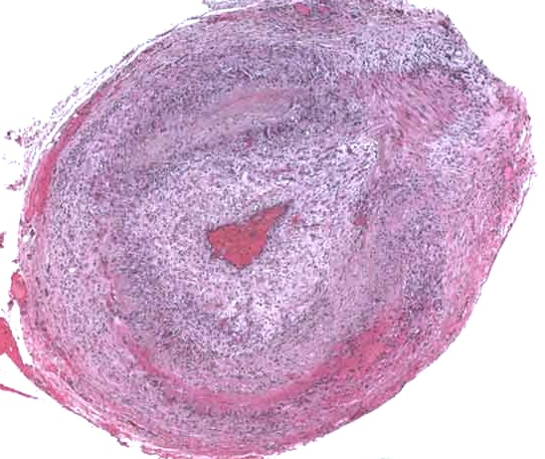
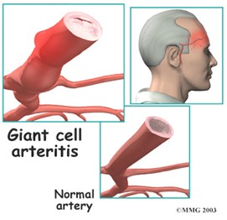
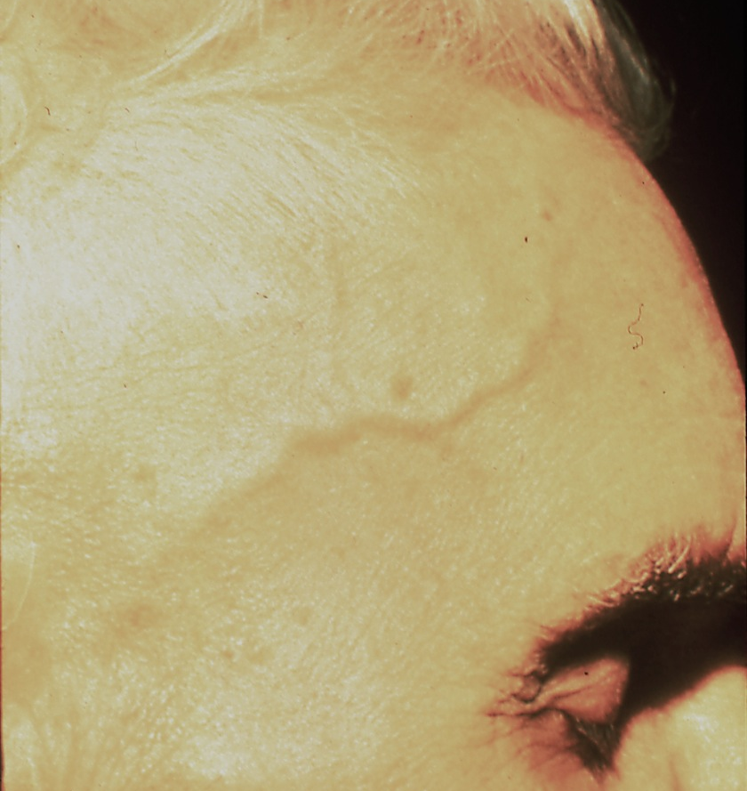
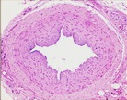
The temporal arteries may appear prominent and tender, but often they look normal, so this sign is specific, but not sensitive for diagnosis
Notes:
The temporal arteries may appear prominent and tender, but often they look normal, so this sign is specific, but not sensitive for diagnosis

Slide 9
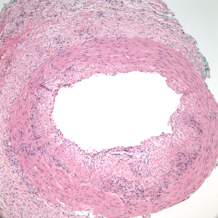
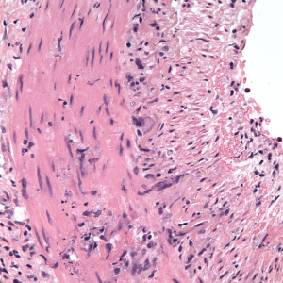
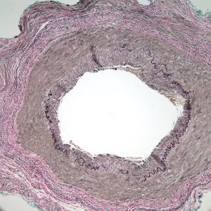
Temporal Artery Biopsy is the Accepted “Gold Standard” for Making the Diagnosis
Mulinucleated giant cell
in media of temporal artery
elastin stain showing disruption of internal elastic lamina
Hematoxylin & Eosin Stain
Verhoeff-Van Gieson Stain
Notes:
Pathologically, there are giant cells and lymphocytes in the wall of medium sized arteries containing elastic lamina and the pathologic confirmation is the gold standard for diagnosis

Slide 10
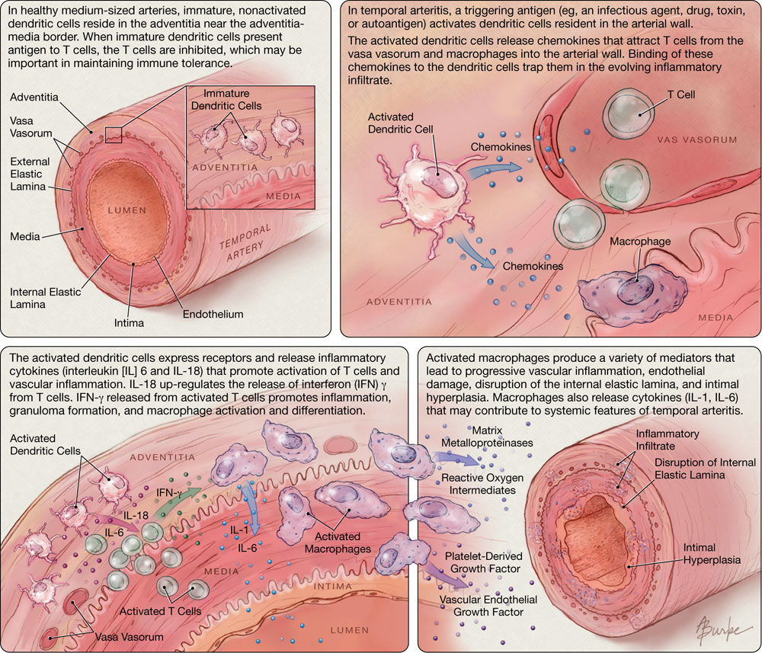
Model for the pathogenesis of giant cell arteritis. (From Shermling RH: An 81-year-old women with temporal arteritis. JAMA 295:2525-2534, 2006.)

Slide 11
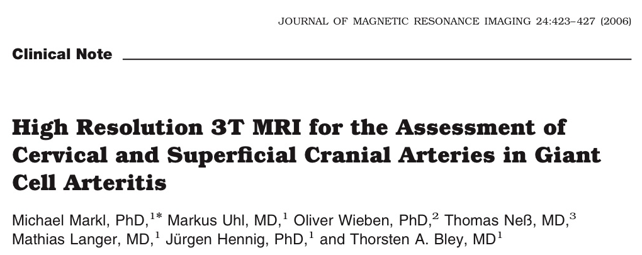
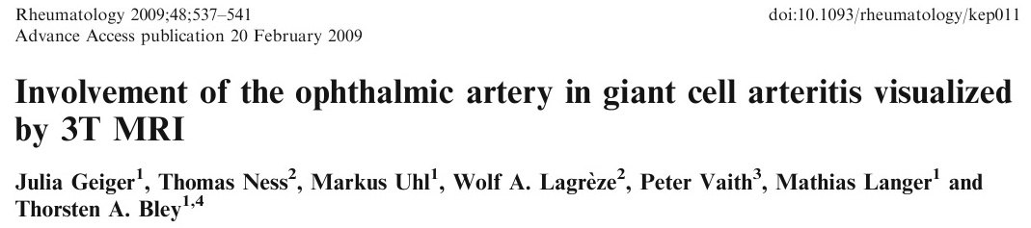
MRI Findings in Giant Cell Arteritis

Slide 12
A - Photograph of a patient with giant cell arteritis demonstrating the swollen frontal branch of his left superficial artery.
B - Small volume projection of the localizer sequence reveals the vessel’s track.
C - T1 sequence before and
D - after intravenous contrast. Note bright contrast enhancement of the thickened wall (arrow) indicating mural inflammation.
Notes:
Co-localization of the temporal artery en face view (top figures) with the MRI cross sectional view (bottom figures). Localizers (white round dots in top figures) were used to register the MRI with the external skin localization of the temporal artery.

Slide 13
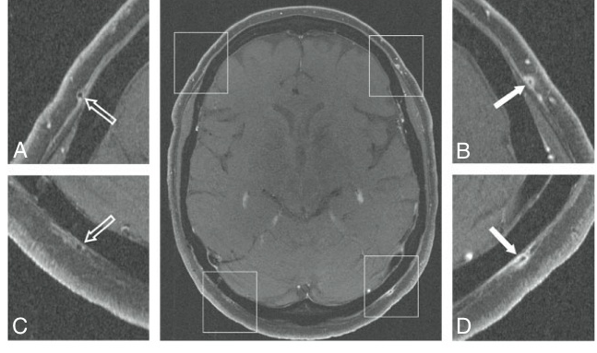
MRI Showing Temporal Artery Enhancement
no enhancement
enhancement
Notes:
The temporal artery on the right side of the head shows no enhancement on fat suppressed MRI with gadolinium whereas the left side shows definite enhancement in the area surrounding the adventitia of the artery (insets on the right)

Slide 14
Contrast MRI Image With Strong Mural
Enhancement Of The Temporal Artery
Notes:
MRI showing gadolinium enhancement of the area surrounding the temporal artery (arrow) after fat suppression.

Slide 15
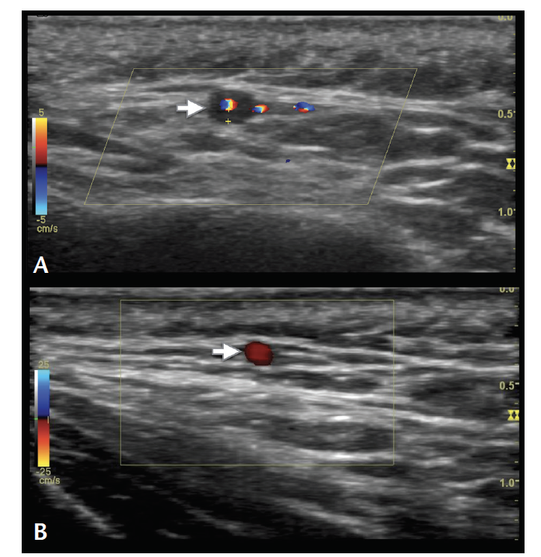
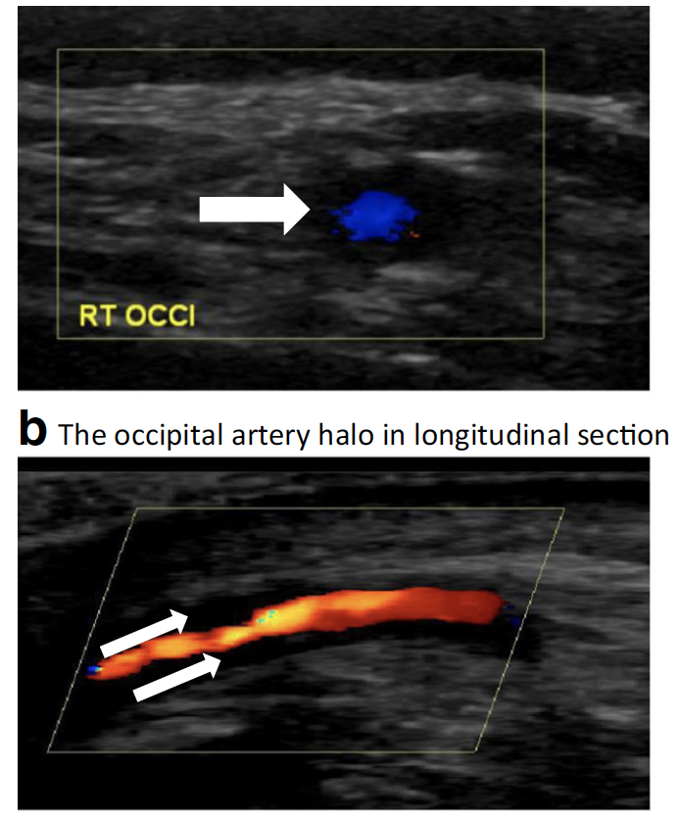
Ultrasound in the Diagnosis of GCA
GCA temporal artery – halo sign
GCA occipital artery – halo sign
normal temporal artery

Slide 16
Giant Cell Arteritis
Visual Symptoms
The patient may only have ocular symptoms without any systemic complaints – “occult” giant cell arteritis in 20%
transient visual loss, especially with change in position - bending over, standing up
transient double vision due to eye muscle ischemia
abrupt, profound visual loss in one or both eyes, or in rapid succession (days to weeks)
Notes:
Some patients only have ocular symptoms and no other systemic symptoms = “Occult Giant Cell Arteritis”

Slide 17
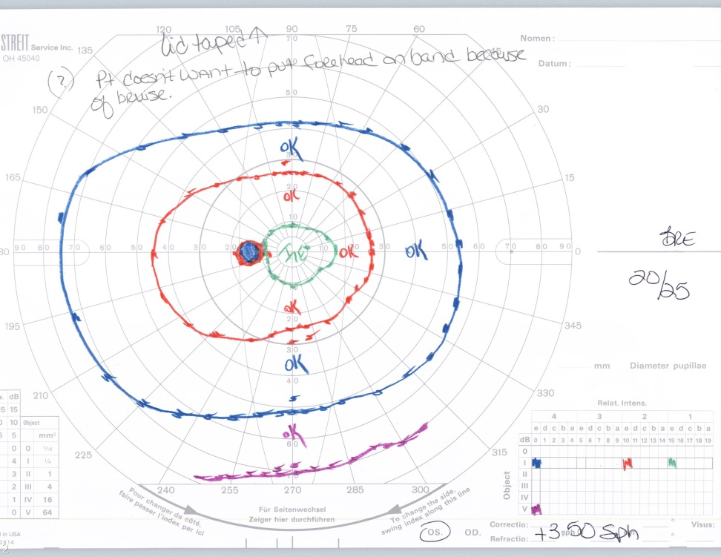
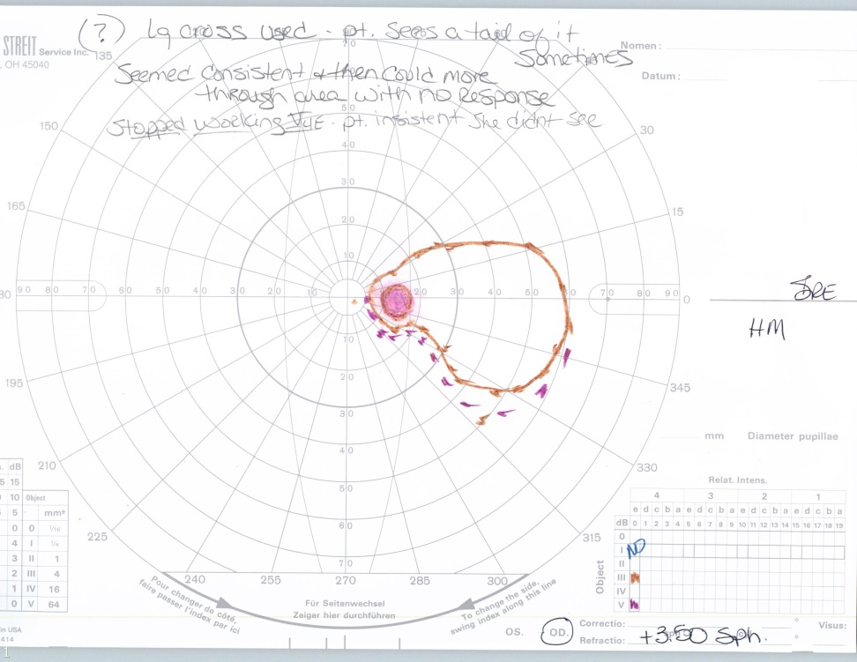
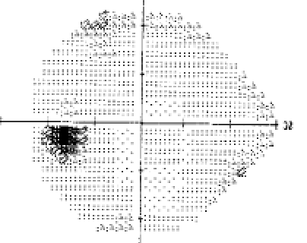
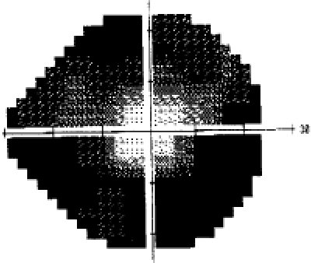
81 y.o. awoke with vision loss OD
Acute vision loss OD
20/70 OD 20/40 OS
ESR 92 mm/hr, CRP 1.2 mg/dl
Headaches at right temple, no scalp tenderness, + jaw claudication, no transient vision loss, no fevers, no weight loss, no shoulder/hip pain

Slide 18
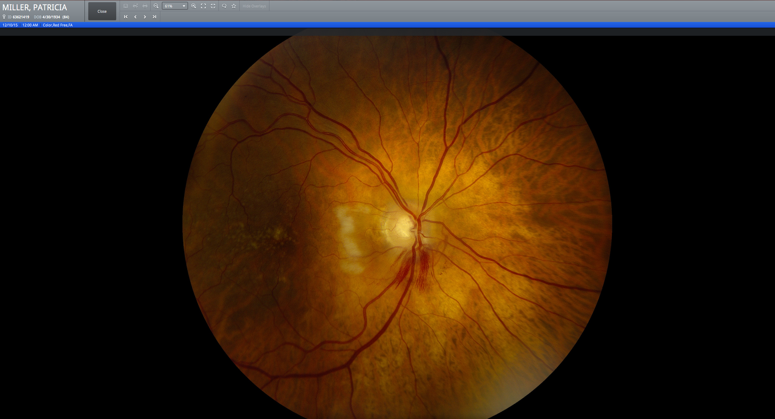
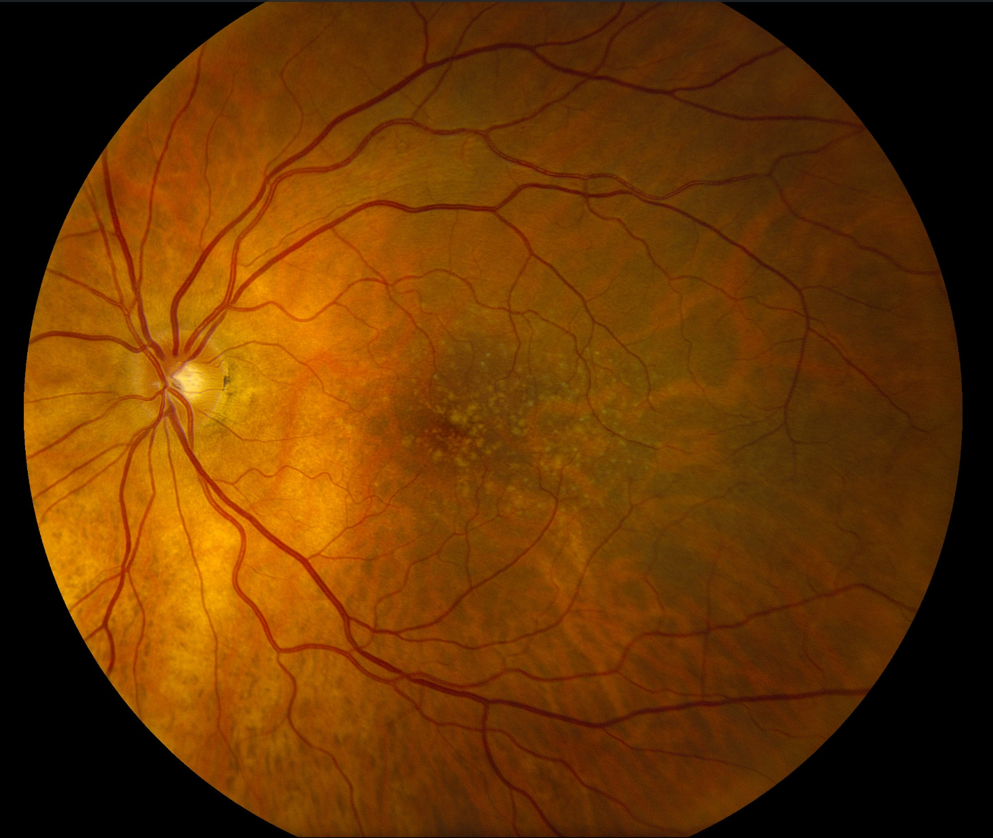
81 y.o. awoke with vision loss OD
Acute vision loss OD
20/70 OD 20/40 OS
ESR 92 mm/hr, CRP 1.2 mg/dl
Headaches at right temple, no scalp tenderness, + jaw claudication, no transient vision loss, no fevers, no weight loss, no shoulder/hip pain

Slide 20
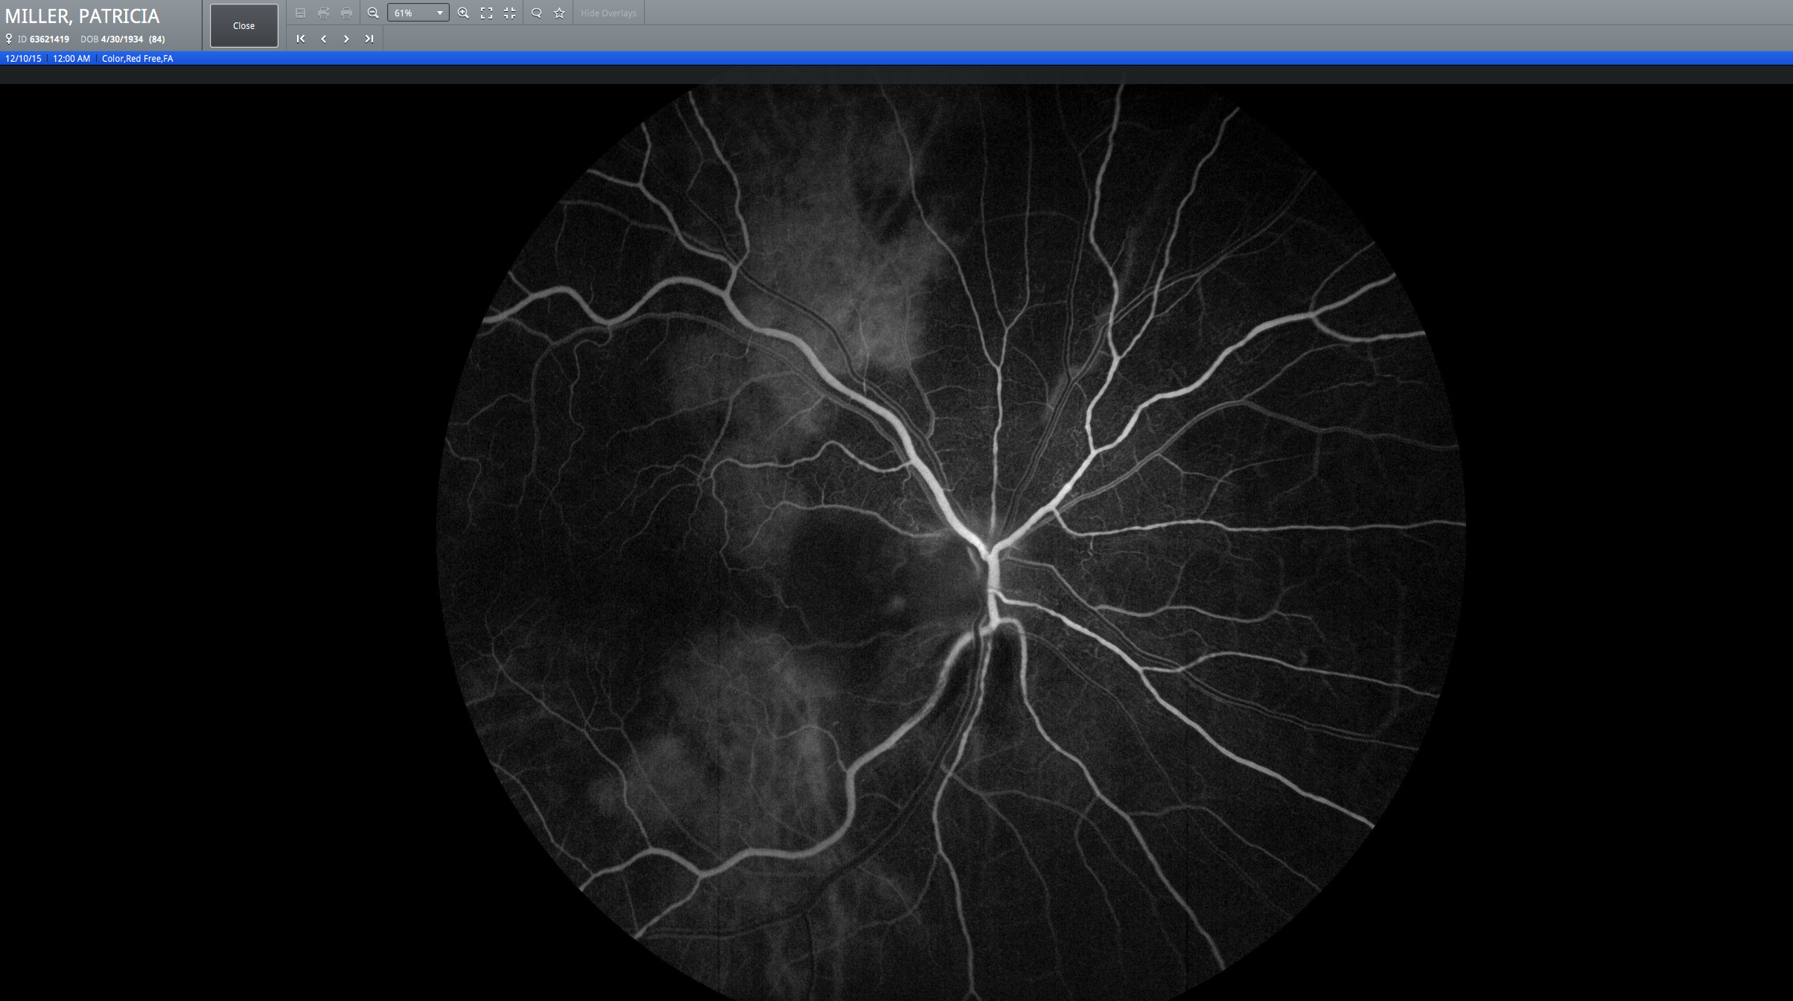

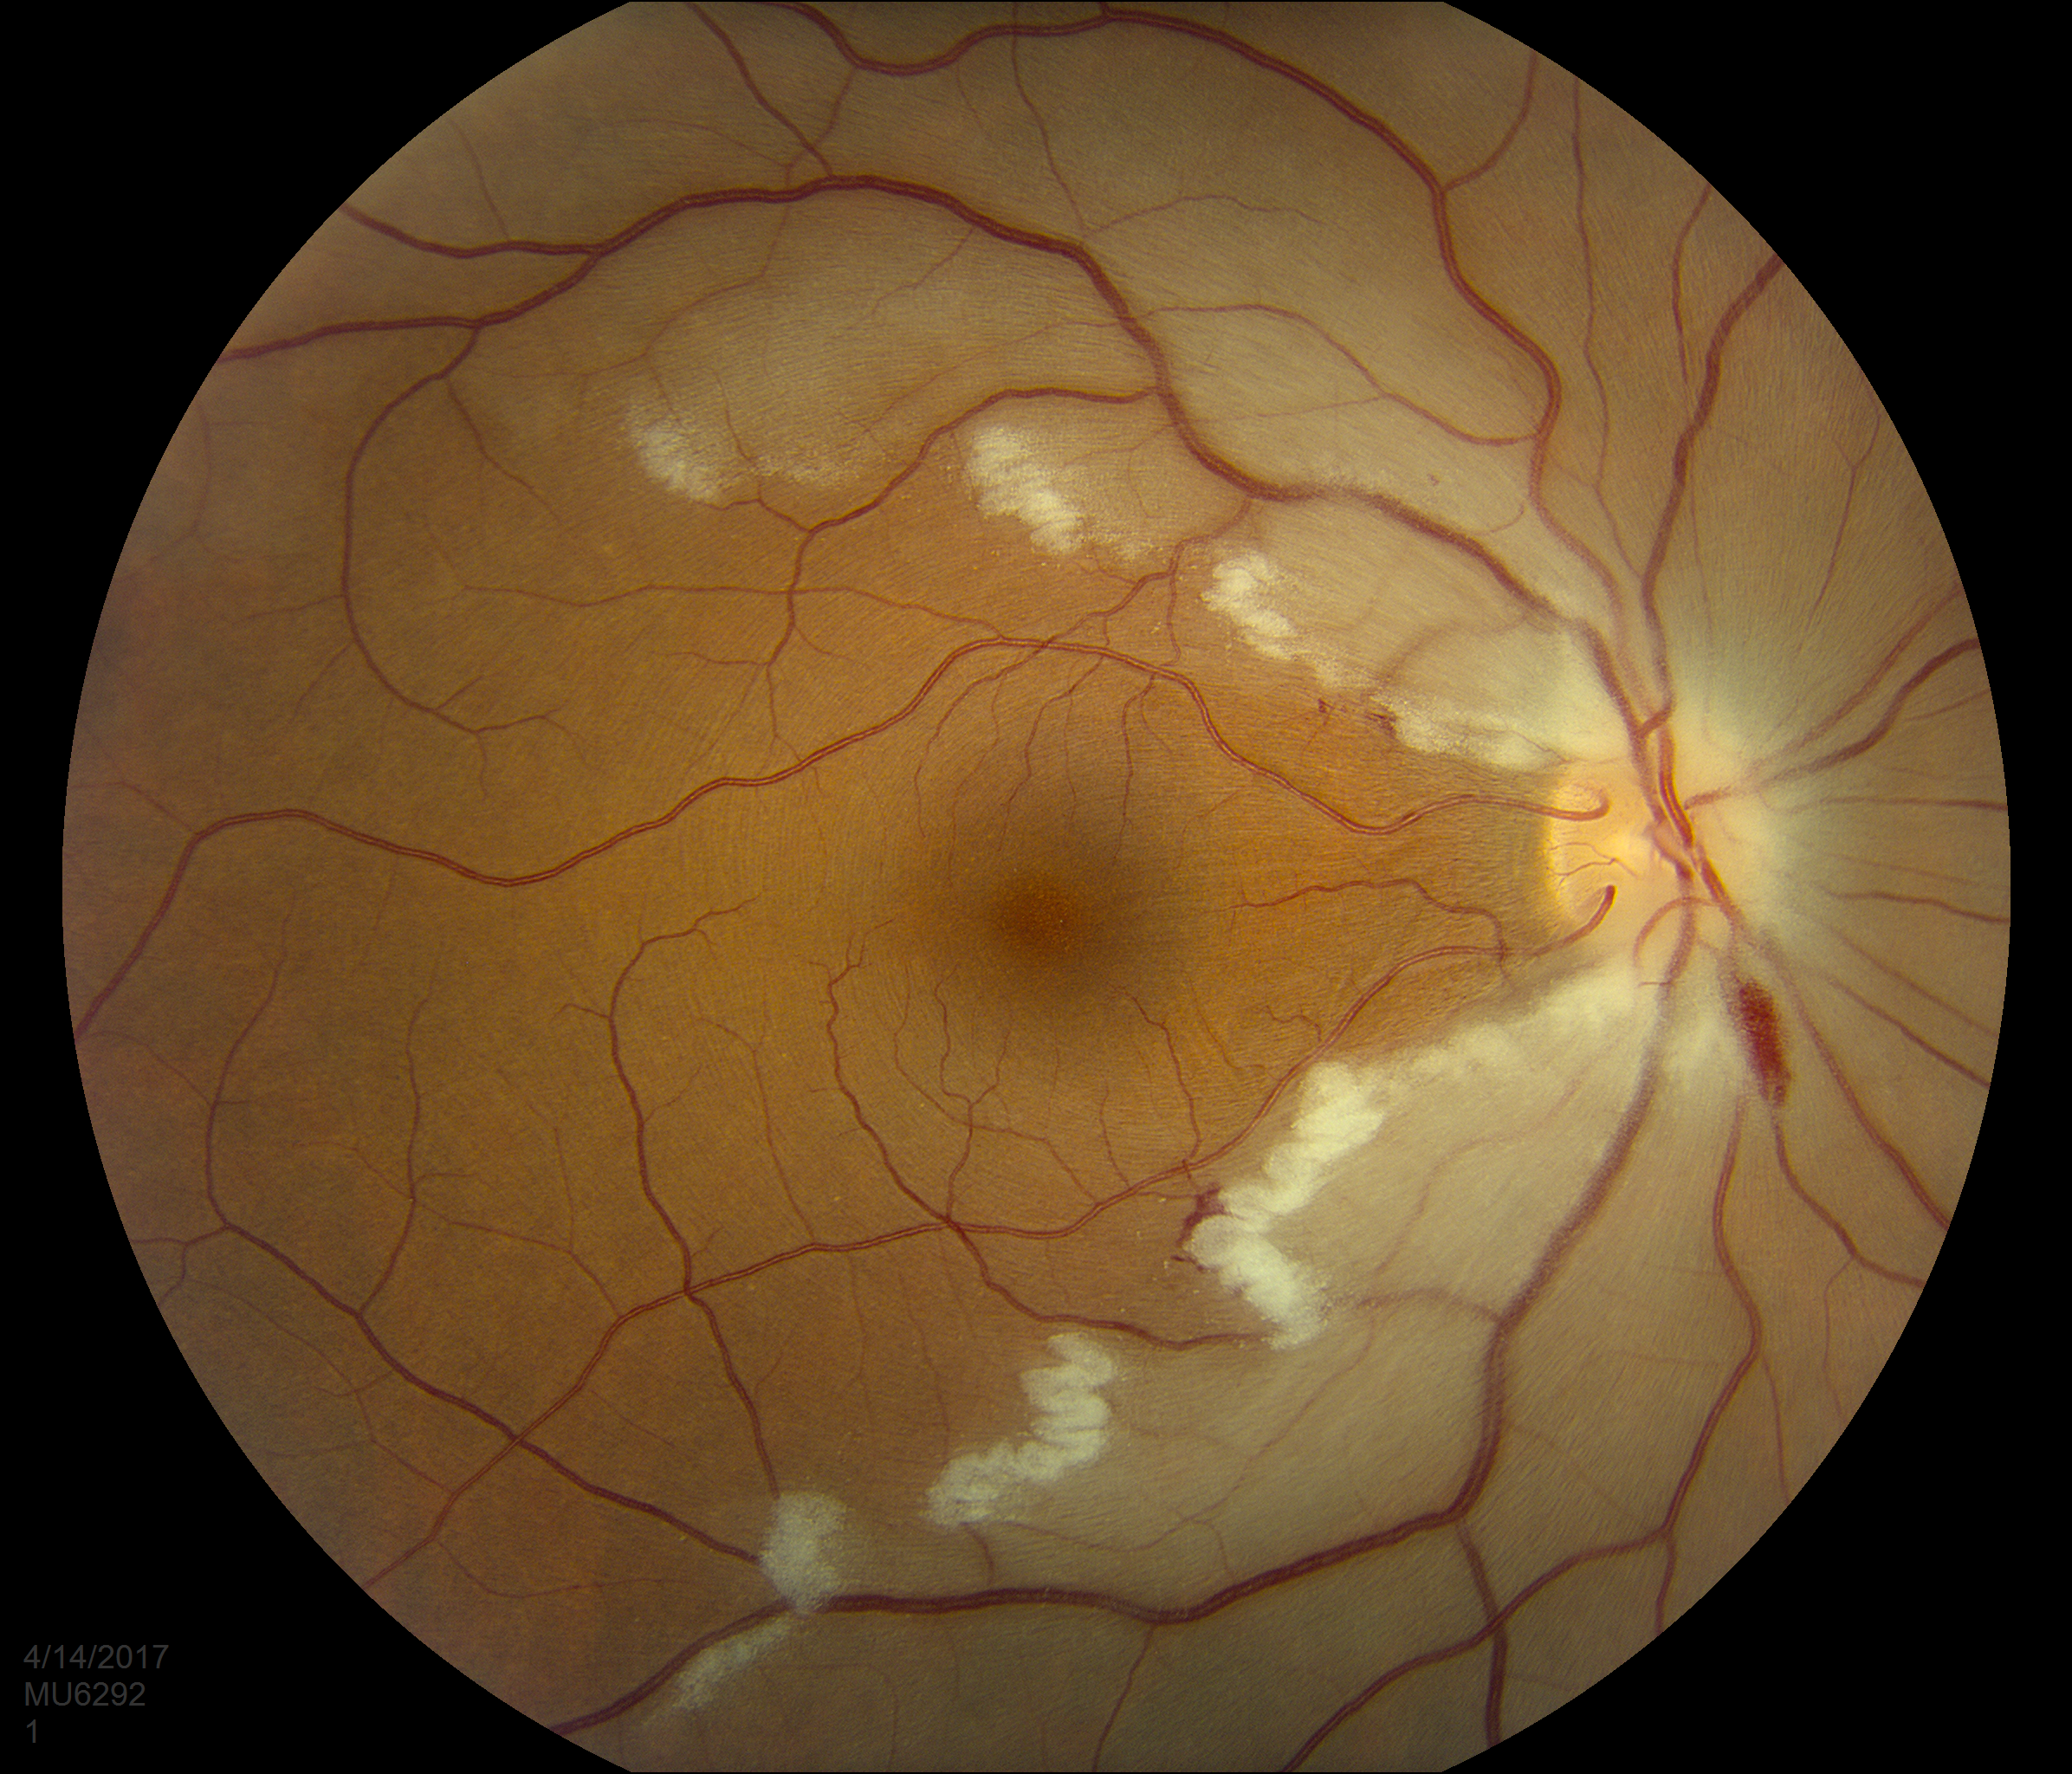
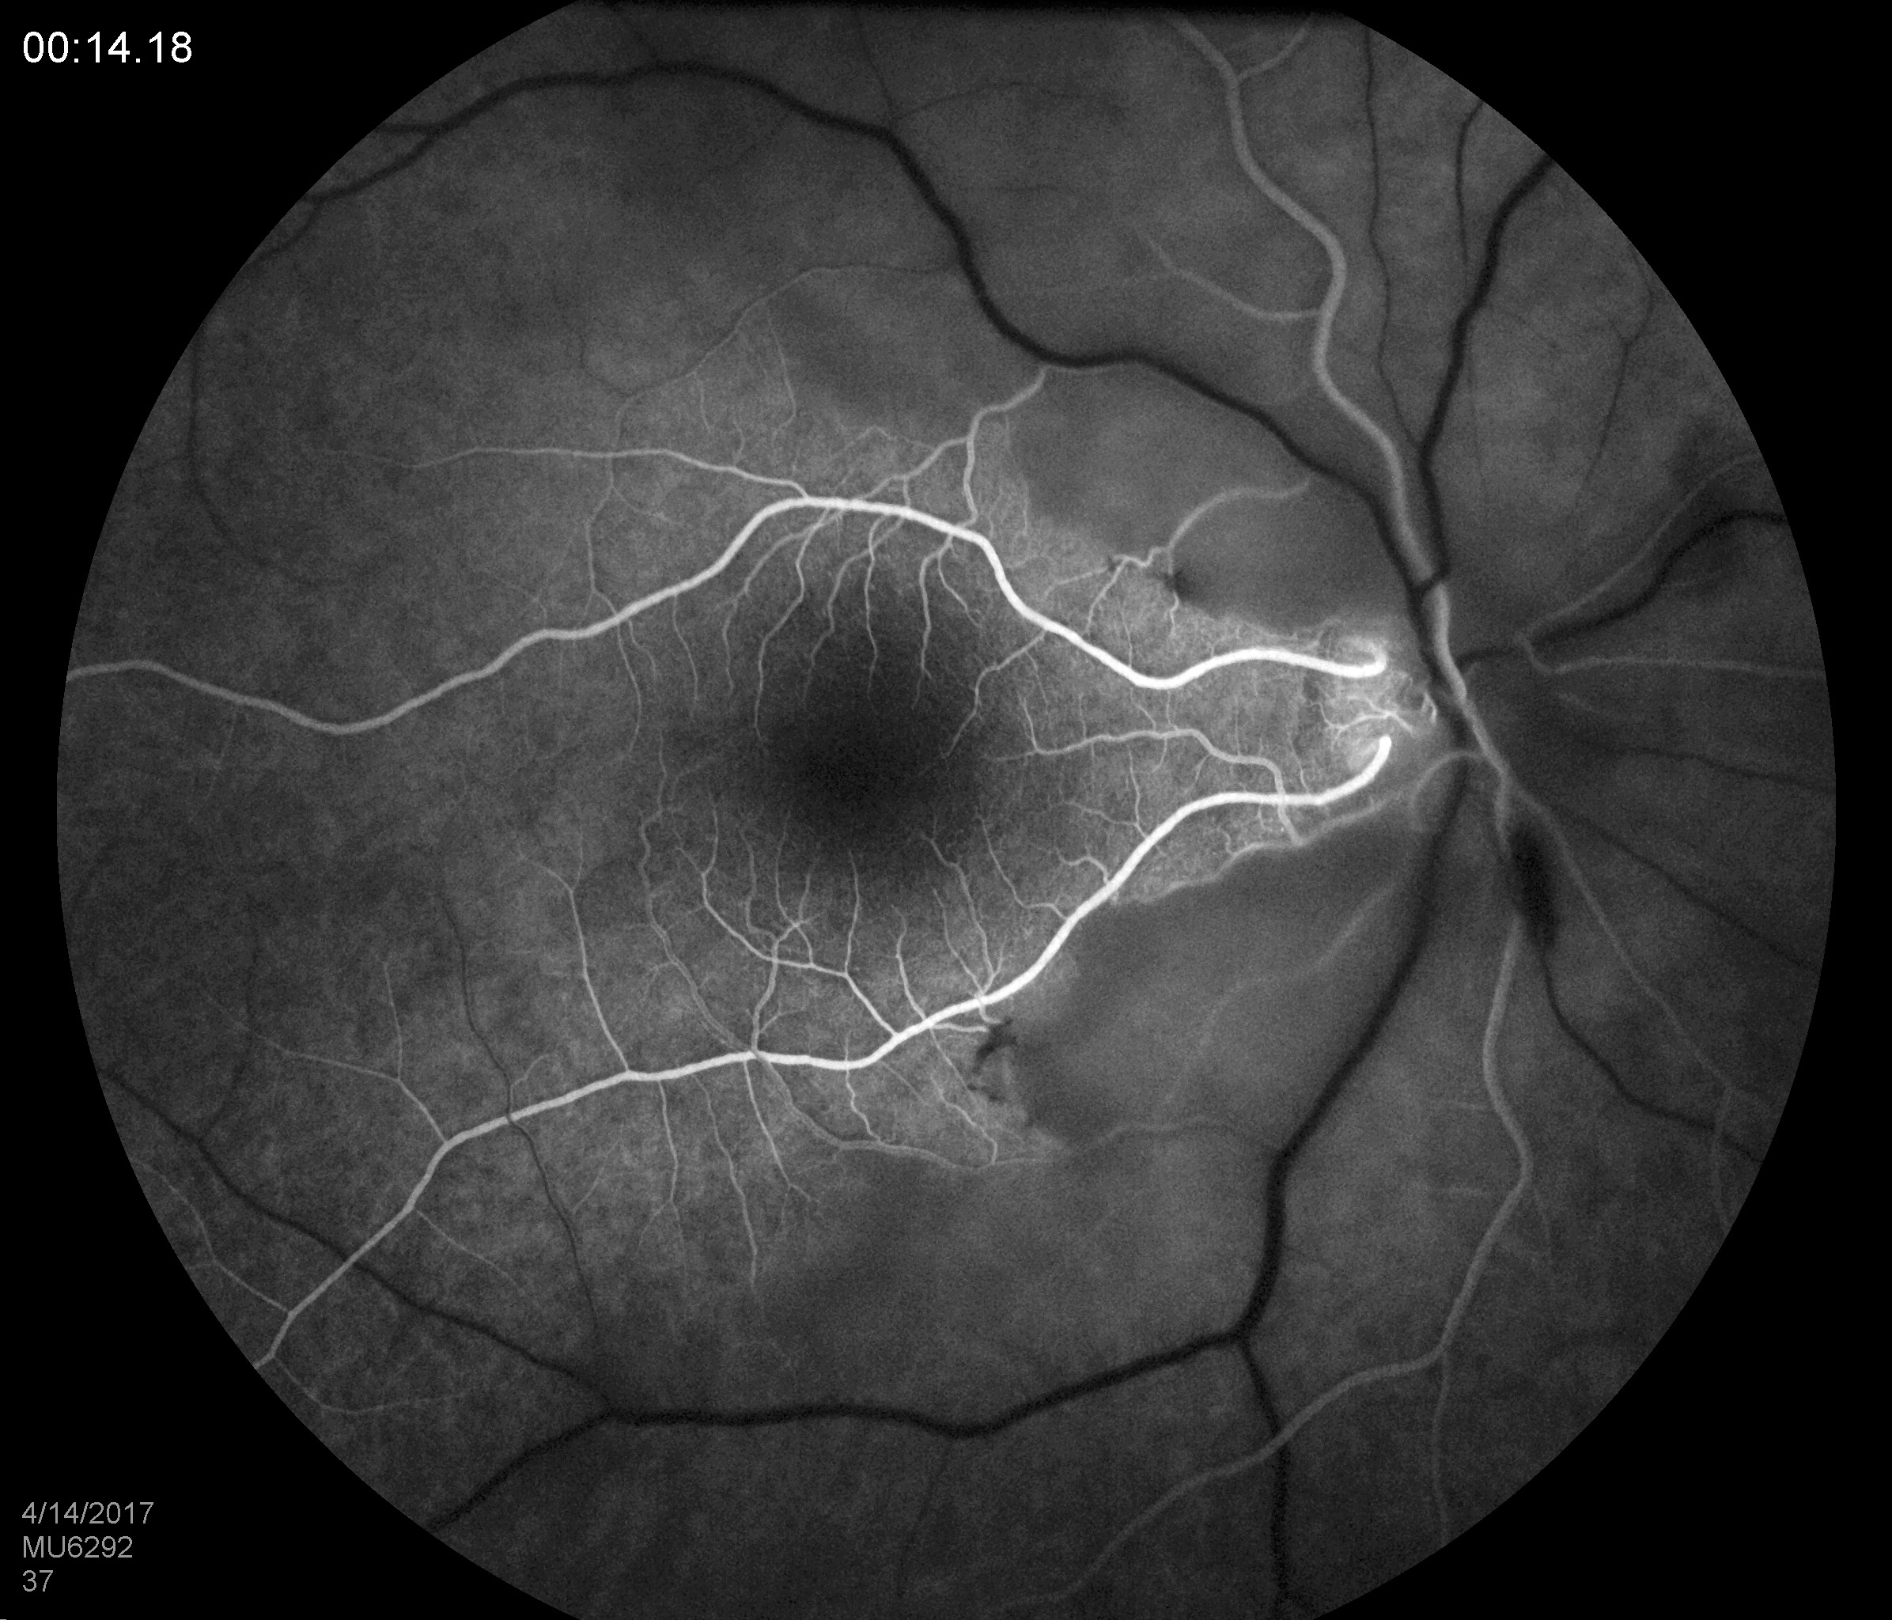

Slide 21
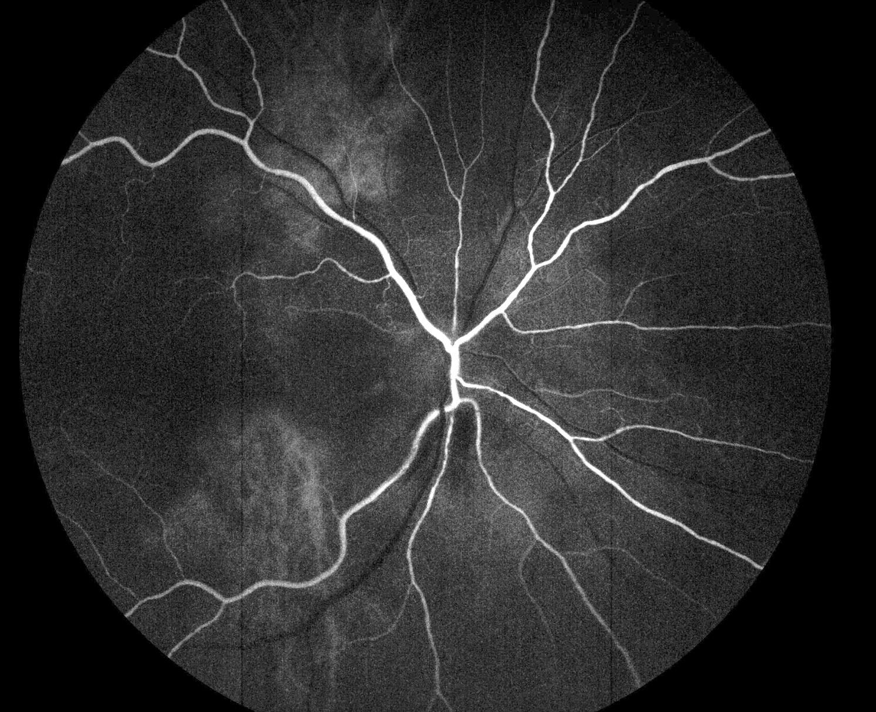
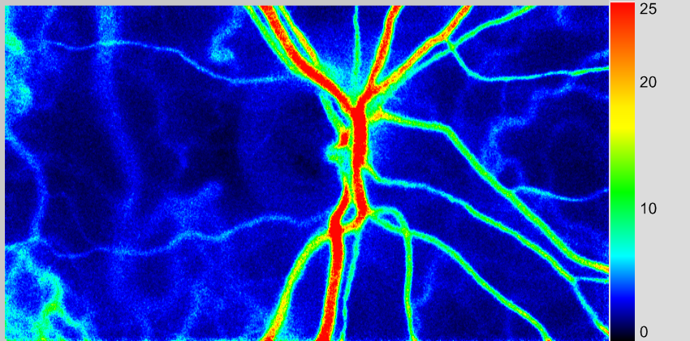
Fluorescein angiography
Laser speckle flowgraphy
Notes:
Patient Name: Patricia Miller MRN: 63621419
Project Number of Patient: 200
Diagnosis: GCA; Acute AION OD awoke with vision loss 11-17-2015; cilioretinal artery occlusion OD FFA and laser speckle OD 12-10-2015
Affected Eye: OD
Normal Eye: OS

Slide 22
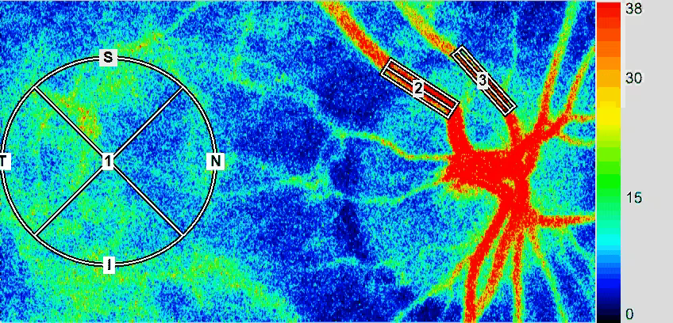
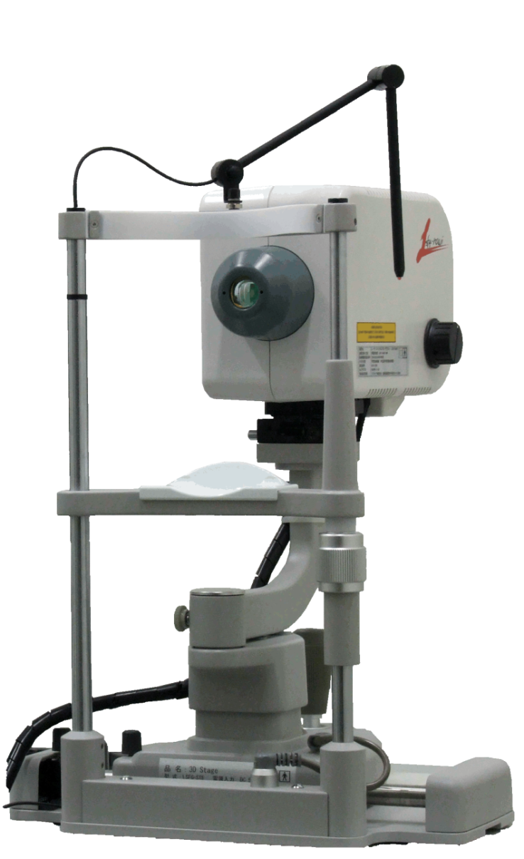
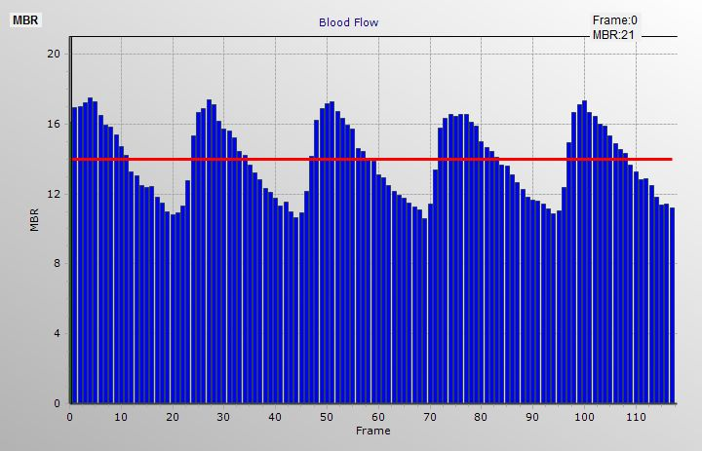
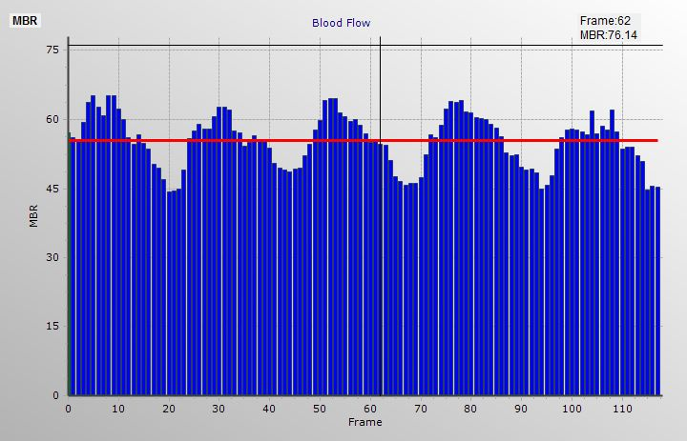
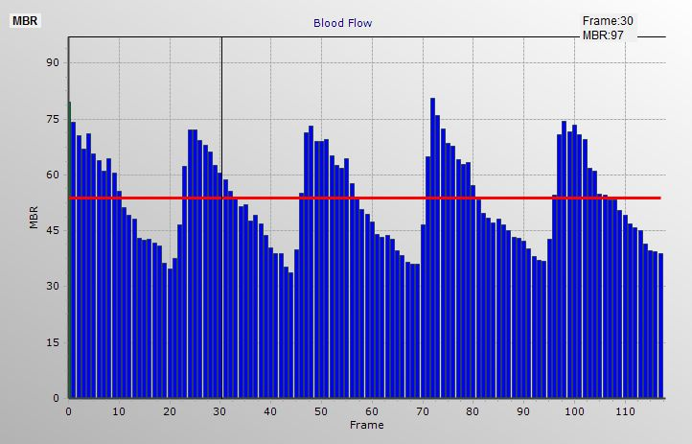
Introduction to Laser Speckle Flowgraphy (LSFG)
Cardiac Cycle Systole and Diastole
Choroid
Vein
Artery
Hitoshi. Fujii Hon. Prof. at KIT
Notes:
This motion picture demonstrates the blood flow change in retinal vessels, tissue of optic nerve head and the choroid of human eye. You note the blood flow changes periodically being synchronized with the heart beats. From this time-varying map you may realize the LSFG’s potential to become a useful tool, not only for diagnoses of various eye diseases, but also for studying the functions of cardiovascular system.

Slide 23
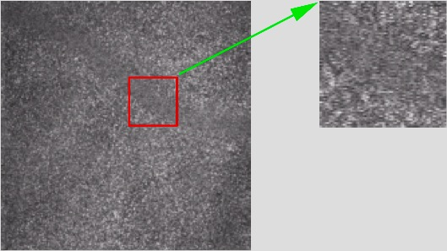
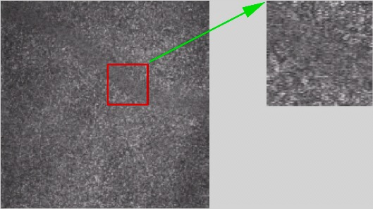
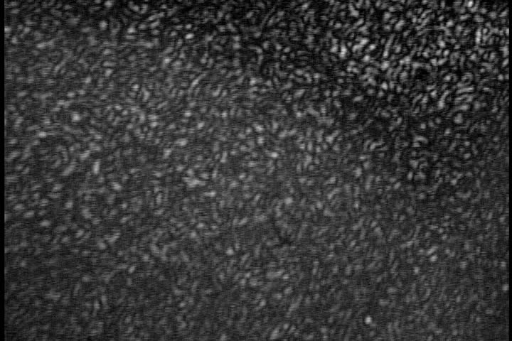
Principle of Laser Speckle Flowgraphy
Blurring of speckle pattern
by moving blood
Blood cells blur moving speckles in the image plane.
Notes:
Let me explain first the principle of LSFG-NAVI.
When the coherent light illuminates the group of the scattering cells on the retina, and reflects back to an imaging system, a random interference pattern, or so-called speckle pattern appears in this image plane.
The brightness of each image point depends on whether most of the wavelets from these scattering cells at the corresponding object point on the retina are superimposed in phase, or out of phase.
Such interference conditions vary in time, when the scattering cells or the blood cells are moving.
Therefore, the structure of the speckle pattern also varies in time, and its rate of variation depends on the average velocity of the blood cells.
When the blood flow in a particular area becomes faster, the speckle intensity at its image point varies faster, and vice versa.
In the LSFG system, we put an image sensor or a high-sensitive CCD camera on this image plane, and capture a series of speckle images and store them in the memory of PC.
From these speckle images, we calculate the motion speed of the time-varying speckles at each pixel point, using a personal computer.
The results are plotted in 2-D map, which indicate the blood flow distribution in the subject.

Slide 24
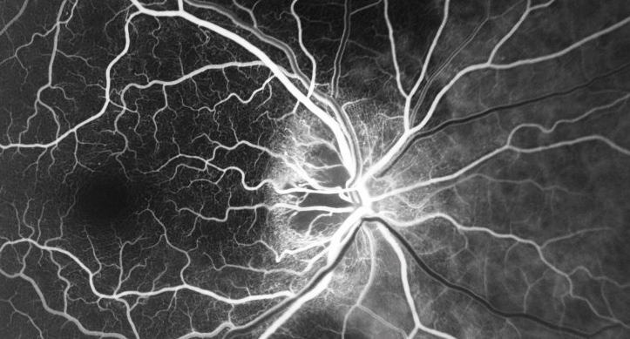
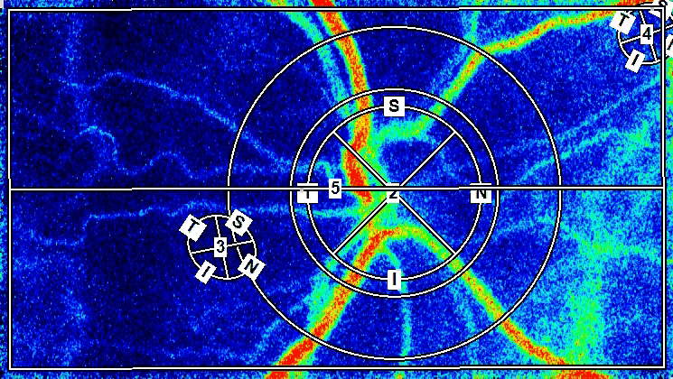
Acute Arteritic Ischemic Optic Neuropathy Due to
Temporal Arteritis – Lateral Posterior Ciliary Artery Occlusion
Notes:
11/6/2014

Slide 25
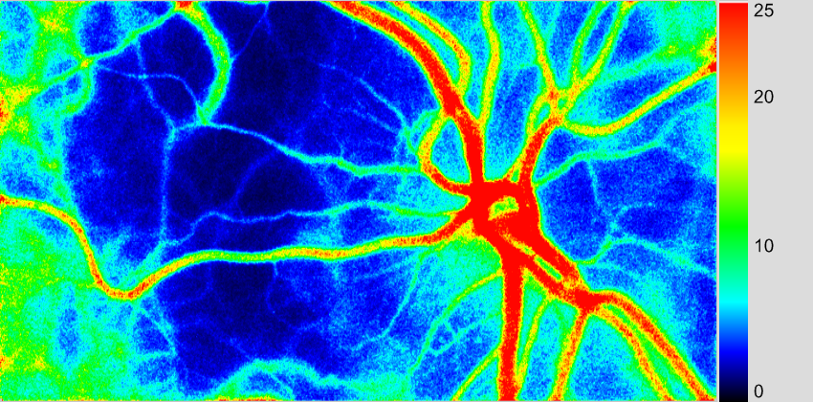
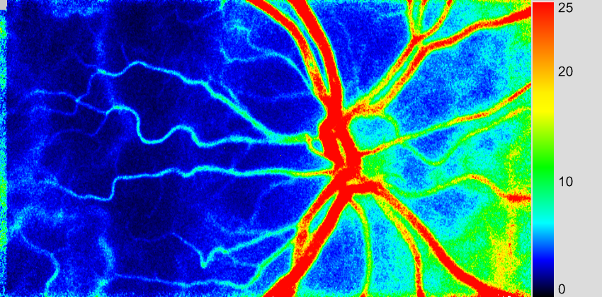
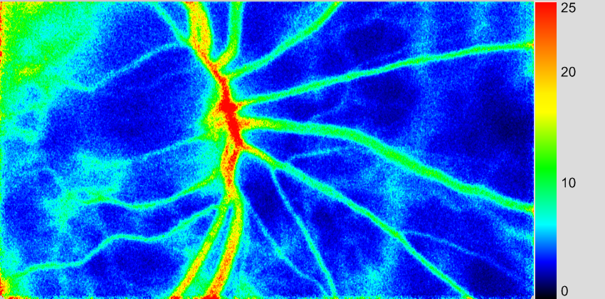
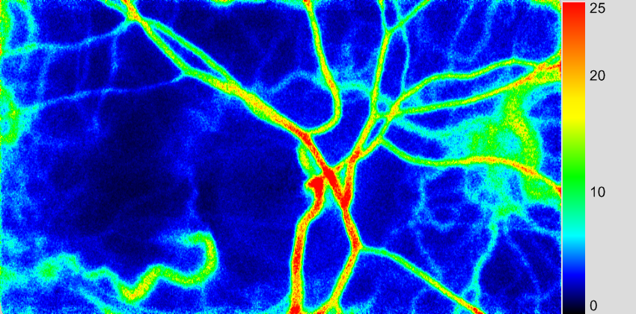
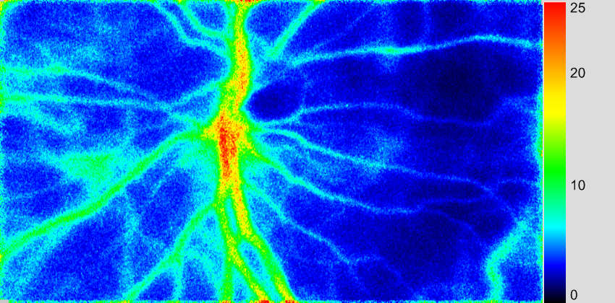
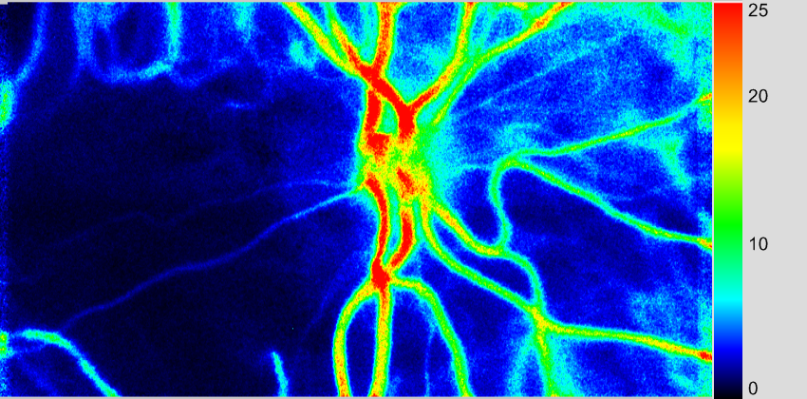
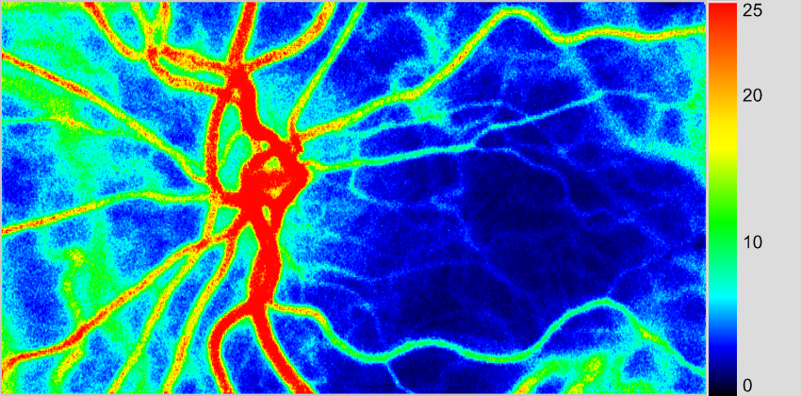
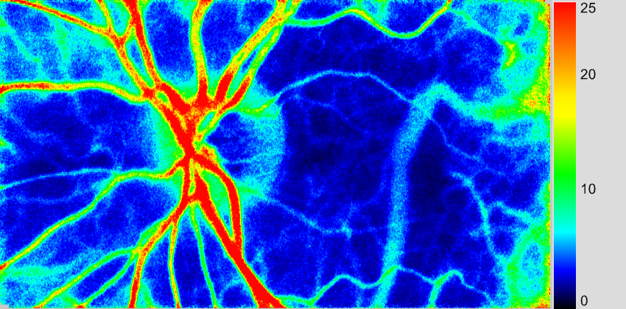
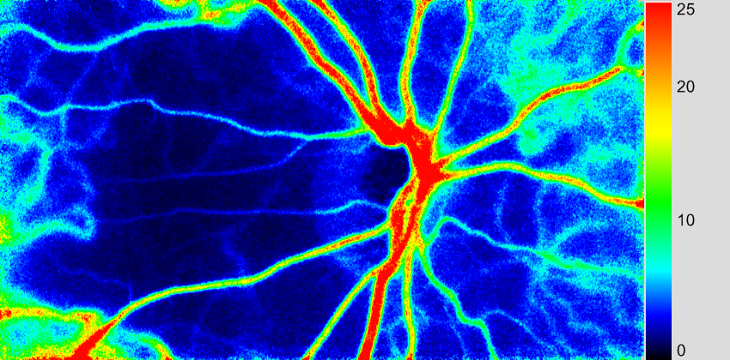
Acute Arteritic AION Eyes

Slide 26
Giant Cell Arteritis
Cause of Visual Loss
Anterior Ischemic Optic Neuropathy (AION)
= infarct of the optic nerve head due to occlusion of the posterior ciliary artery
Notes:
Visual loss is due to ischemia to the optic nerve from a compromised vascular supply

Slide 27
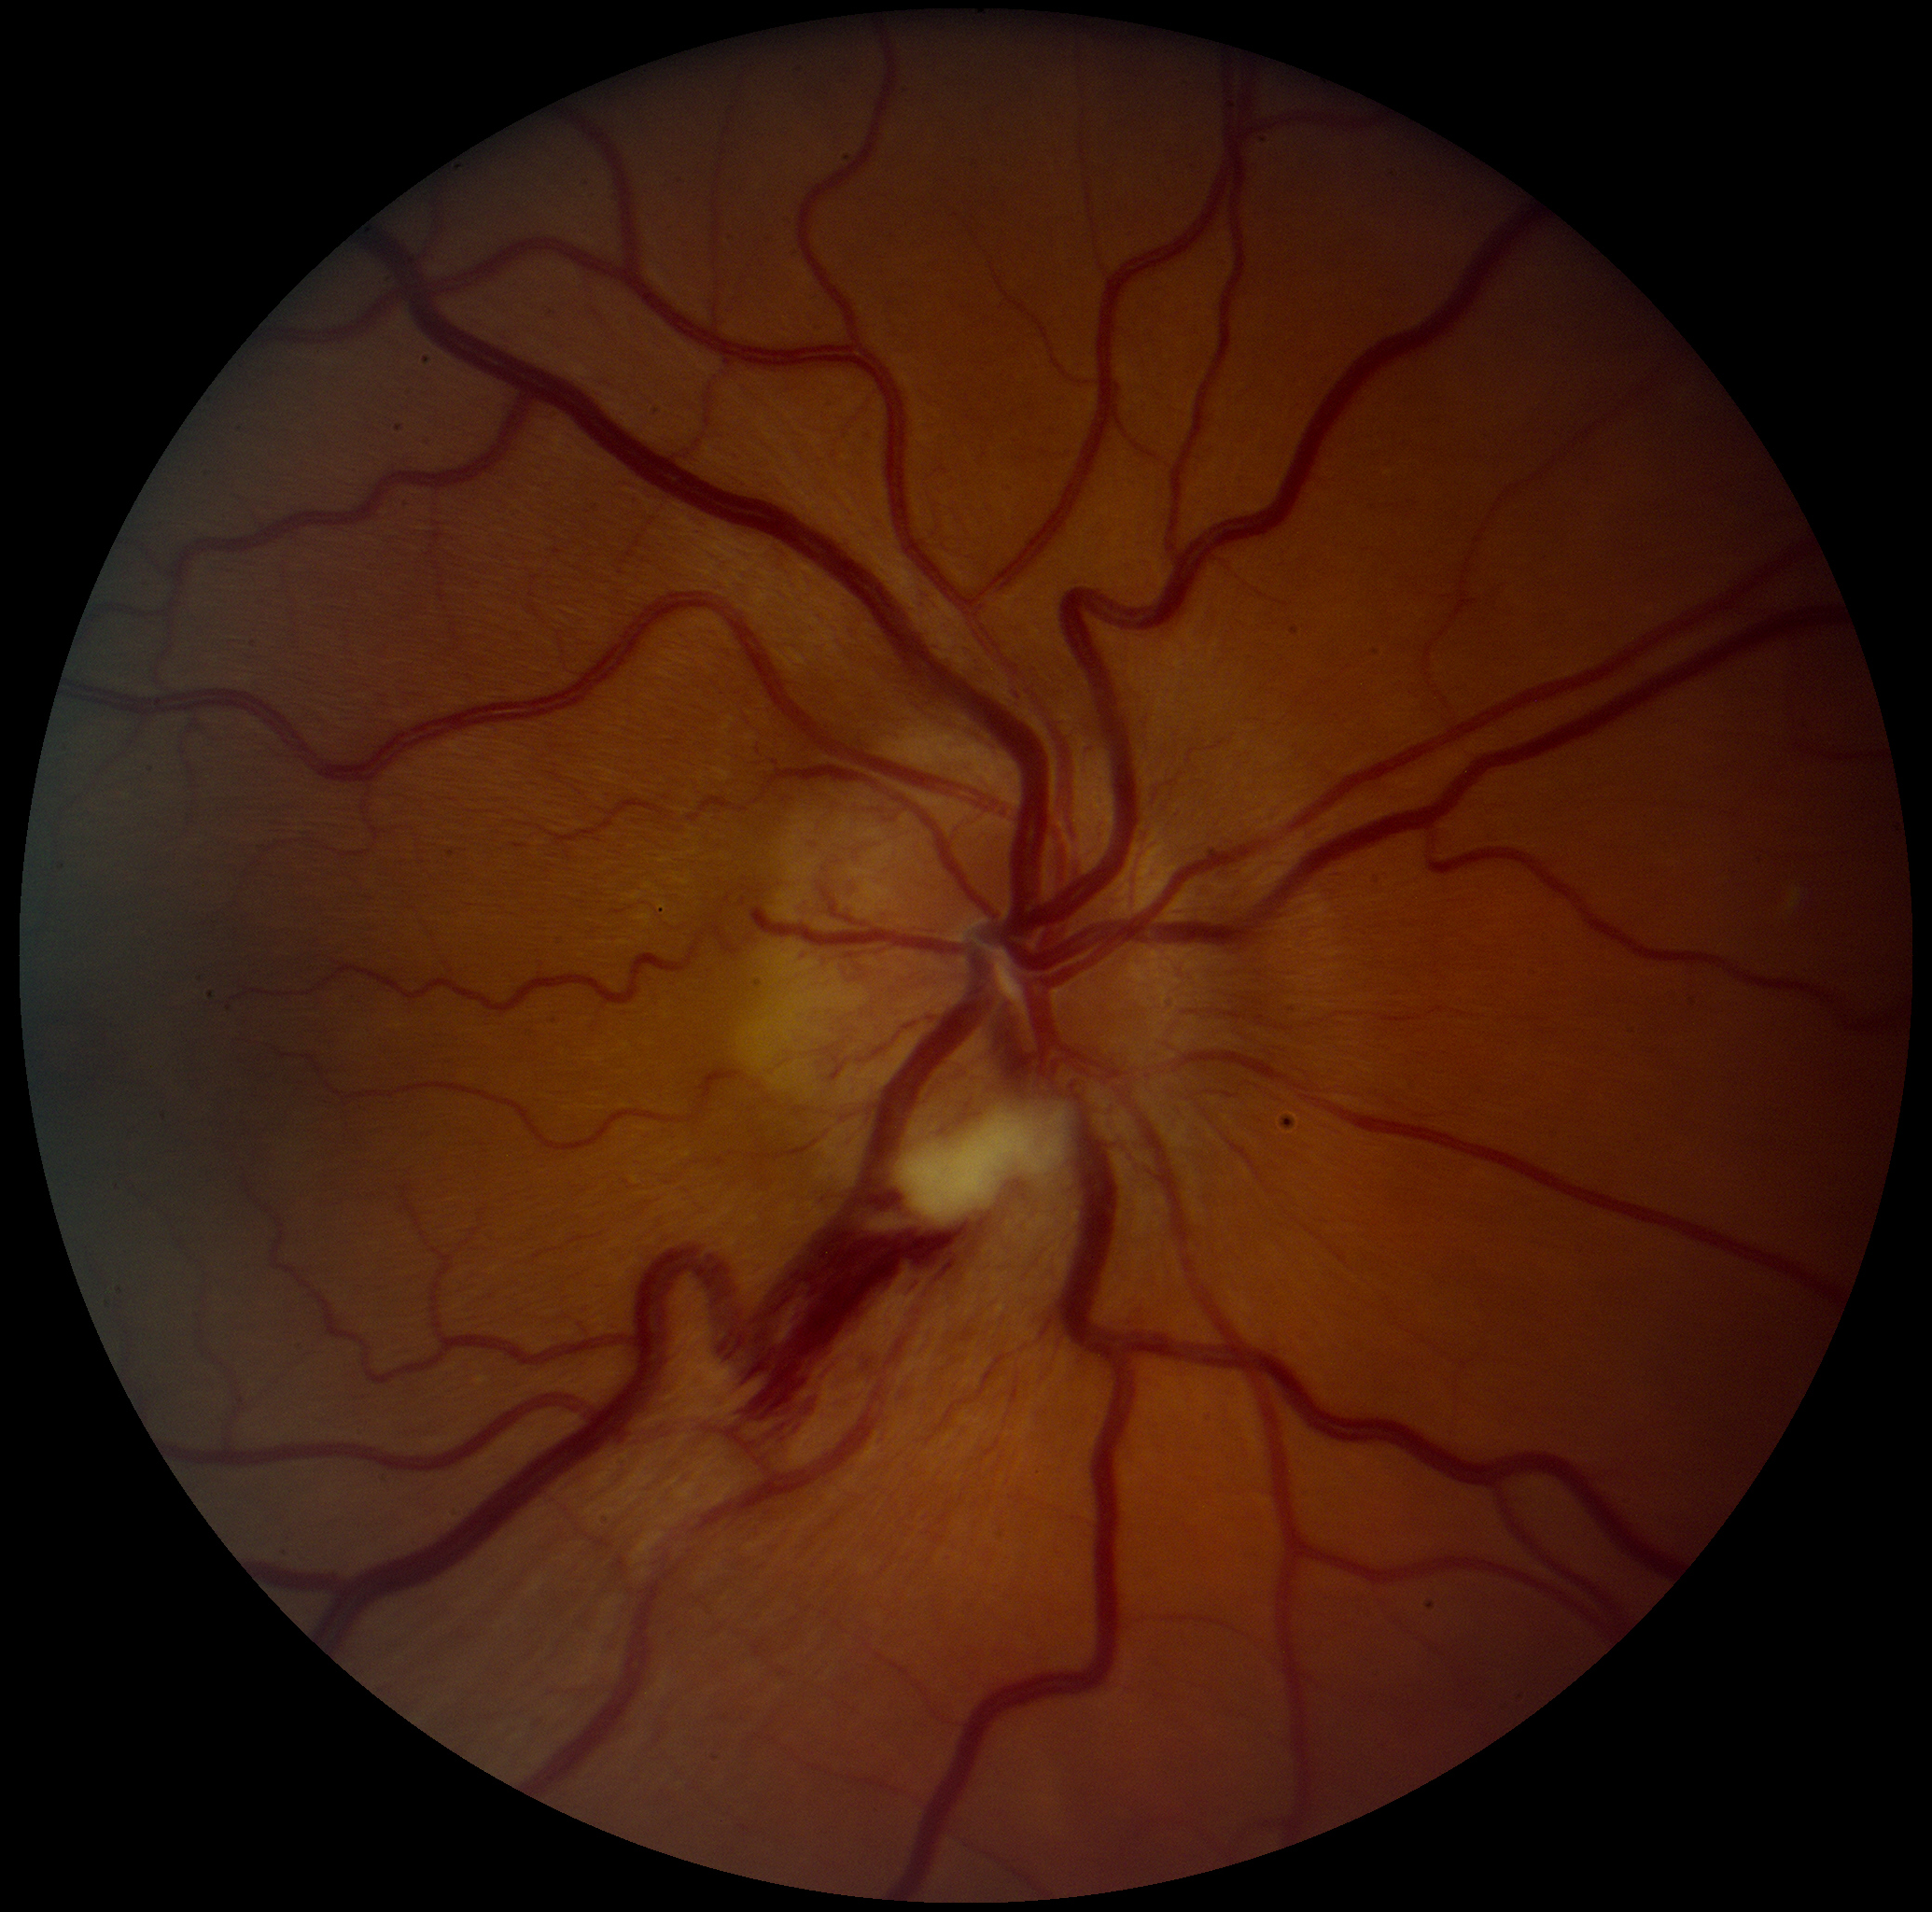
Acute Anterior Ischemic Optic Neuropathy
Optic Disc Edema
Notes:
The ischemic optic nerve looks swollen on fundus exam and may contain hemorrhages and cotton wool spots (micro-infarcts of the retinal nerve fiber layer)

Slide 28
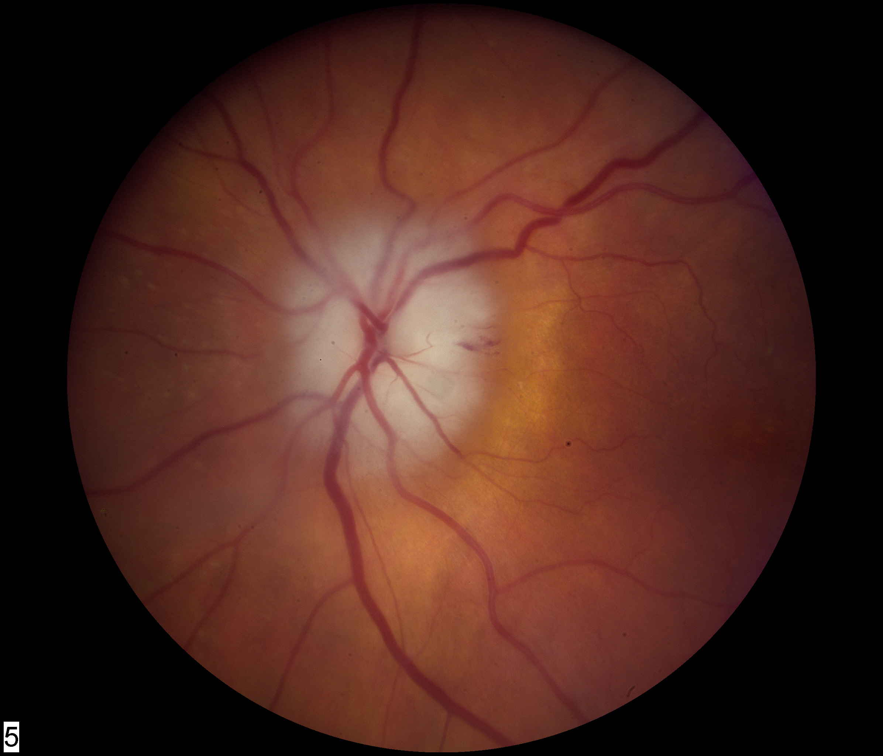
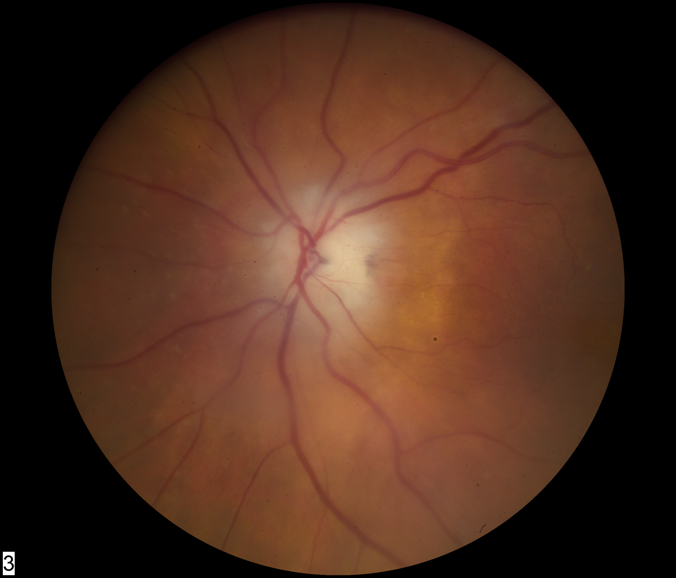
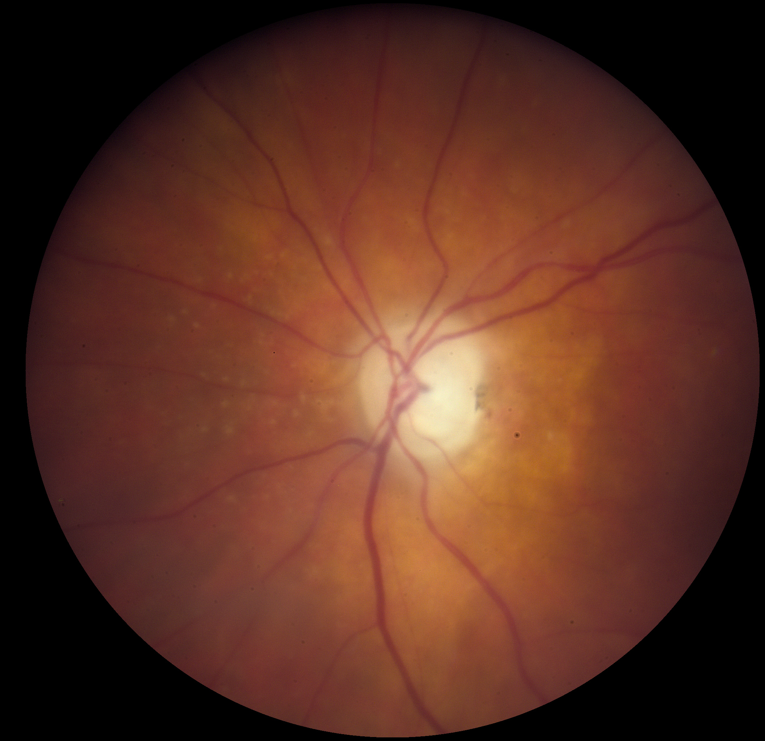
Pallid (Pale) Optic Disc Edema
=Optic Nerve Head Infarction
Acute
3 weeks
swelling
6 weeks
Optic nerve swelling
goes away over time,
but vision loss is permanent….
atrophy+cupping
Notes:
Acutely the optic nerve is swollen and may be pale (pallid swelling) from the infarct, but with time (over 6-12 weeks) the swelling goes away, leaving a pale nerve

Slide 29
Mapping of Visual Field Damage:
Inferior or Superior Altitudinal Field Loss is Commonly a
Result of Anterior Ischemic Optic Neuropathy
left eye field of view
right eye field of view
small, dim spot
“isopter”
absent inferior visual field
large, bright spot
“isopter”
Field of view of from the patient’s perspective looking out into space
Notes:
Optic nerve damage translates to loss of function in the visual field either in the center or periphery or both and this is tested clinically with visual field testing (termed perimetry)

Slide 30
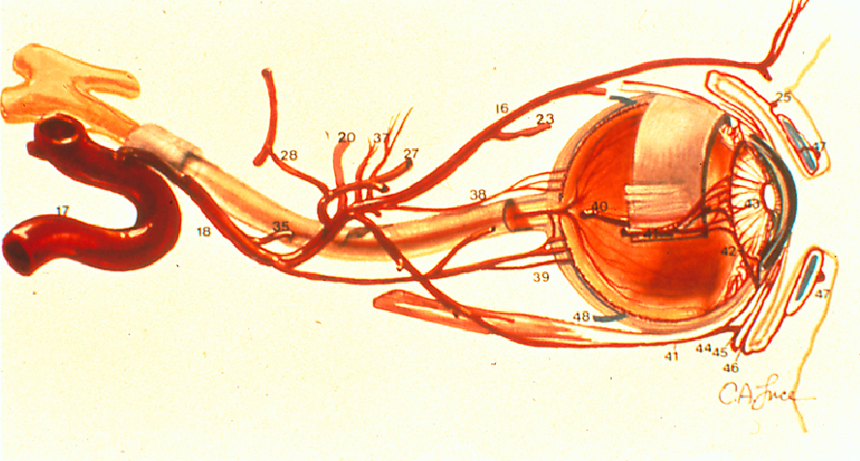
Ocular Arterial Circulation
Muscular Artery
supplies eye muscles
central
retinal artery
Carotid
ophthalmic artery
common branch
Posterior ciliary artery
supplies optic nerve head and choroid
(this is what commonly gets occluded in GCA)
Notes:
The posterior ciliary arteries, derived from the ophthalmic artery are the ocular arteries most commonly affected by giant cell arteritis and they supply blood to the anterior optic nerve and the choroidal layer of the eye (vascular layer in between the retina and sclera)

Slide 31
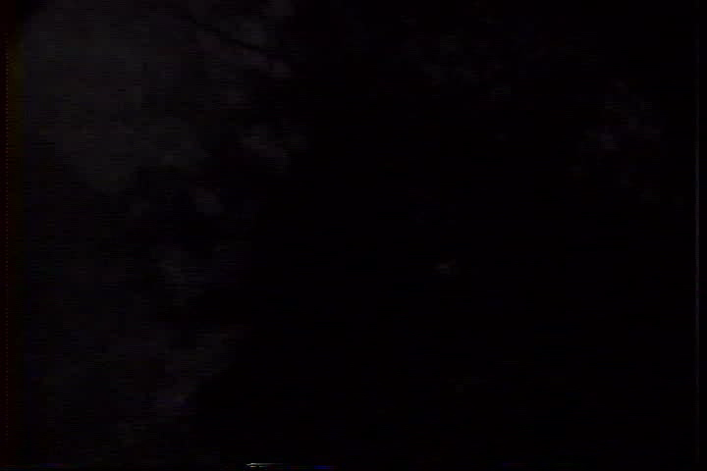
Fluorescein Angiography of the Normal Eye video
Notes:
Fluorescein angiogram video of a normal eye showing sequence of filling of the deeper choroidal circulation and then the central retinal artery and its branches to the superficial retina

Slide 32

Fluorescein Angiography of the Arteritic Eye
video
Notes:
Fluourescein angiogram of a patient with visual loss from giant cell arteritis demonstrating very slow filling of the entire choroid due to narrowing and blockage of the posterior ciliary arteries from the granulomatous inflammation narrowing the vessel lumen

Slide 33


Fluorescein Angiography
Choroidal filling is slowed or absent
15 seconds after injection
5 seconds after injection
Non filling
Slow filling
Lateral Posterior Ciliary Artery Occlusion
resulting in non-filling of choroidal sector, and very slowed filling in the remaining area of choroid
Notes:
Snapshot of two time points during the fluorescein angiogram (black is where the dye is located, because this is a “negative” film) showing non filling of the choroid in the distribution of one of the posterior ciliary arteries and slowed filling in the distribution of the other posterior ciliary artery supplying the choriocapillaris

Slide 34

Arteritic AION
Area of Choroidal Filling Defect
Matches Area of MERG Field Defect
Fluorescein angiography OD
temporal choroidal filling defect
MERG OD
nasal field defect in signal

Slide 35

OS
OS
OD

Slide 36




Cilioretinal Artery Occlusion+AION=GCA
medial posterior ciliary artery occlusion
lateral posterior ciliary artery occlusion

Slide 37


Central Retinal Artery Occlusion +
Posterior Ciliary Artery Occlusion = GCA
Common
Branch

Slide 38

Erythrocyte Sedimentation Rate (ESR) in the Diagnosis of GCA
GCA patients
GCA patients
Normals
Normals
Giant Cell Arteritis: Validity and Reliability of Various Diagnostic Criteria; Hayreh et. al. Am J Ophth 123:285-296, 1997.
Notes:
The erthyrocyte sedimentation rate is helpful because it is an acute phase reaction and is elevated in giant cell arteritis, but it is not specific; other causes of inflammation and infection can also elevate the ESR. Also, it has a wide range in normal subjects, so it may be elevated for a given person but still within the range of normal values in the population.

Slide 39

Relationship Between ESR and
C-reactive Protein (CRP) in GCA
normal subjects
GCA pts:abnl ESR
abnl CRP
GCA pts:nml ESR
abnl CRP
GCA pt:abnl ESR
nml CRP
Notes:
The C-reactive protein is used in conjunction with the ESR, because it, too, is an acute phase reactant in the blood, but has a narrower normal range, so it may show elevation in some patients that have an ESR that is still in the normal range. Both ESR and CRP are helpful for raising the suspicion of the diagnosis of giant cell arteritis, but the temporal artery biopsy is still the gold standard for making the diagnosis. ESR and CRP are also helpful indicators of disease activity that guide treatment with steroids in terms of dose and tapering schedule.

Slide 40
Giant Cell Arteritis
Objectives of Steroid Treatment
There is usually no useful recovery of vision in the involved eye
To prevent involvement of the other eye
To prevent other ischemic complications of giant cell arteritis
To reduce complications of steroid use (tocilizumab, IL-6 inhibitor, in some cases)
Notes:
The main treatment objective is to prevent further loss of vision and complete blindness in both eyes and also to prevent other systemic complications of giant cell arteritis

Slide 41

CRP and Erythrocyte Sedimentation Rate (ESR) Response to Steroid Treatment in 6 Patients
C-reactive Protein mg/dl
Erythrocyte Sedimentation Rate mm/hr
Notes:
The ESR is commonly monitored along with the CRP during treatment to verify that treatment is adequate and to also watch for recurrence, if the dose is tapered too fast or in patients maintained on a low dose of steroids.

Slide 42
Giant Cell Arteritis Take Home Points
Giant cell is an ocular emergency that will result in bilateral blindness if not diagnosed and immediately treated with high dose steroids
Blindness most usually is caused by occlusion of the posterior ciliary arteries that supply blood to the optic nerve head resulting in anterior ischemic optic neuropathy
Giant cell arteritis may cause visual symptoms and blindness without systemic symptoms (“occult giant cell arteritis)
Systemic symptoms may include malaise, scalp tenderness, neck, shoulder, and hip pain, headaches, and jaw claudication
Erythrocyte sedimentation rate (ESR) and C-reactive protein are blood tests used to help in the diagnosis and in monitoring response to steroid treatment
A temporal artery biopsy is used for definitive diagnosis
Many patients need to stay on a maintenance dose of steroids to prevent re-activation of the disease
Notes:
Take home points for giant cell arteritis

